Slide 1
PSYC 4973: Special Topics in Memory
Course Overview
Notes:
Welcome to cognition! Hopefully you are watching this video first!

Slide 2
Who is this person?
Dr. Maxwell
Cognitive Psychologist
  Research interests in memory and language

Slide 3
Contacting Dr. Maxwell
How to contact me:
Email: nicholas.maxwell@msutexas.edu
  Please put course # and section # in header!
  24 – 48 hours (except on weekends)
Phone: ??? (don’t call me ☺)
In person!

Slide 4
What do I get out of this Class?
A deeper understanding of cognitive psychology, including its history and current research trends.
A comprehensive understanding of memory, including how it relates to other cognitive systems (e.g., attention, language, etc.)
An appreciation of the role of memory in everyday life.

Slide 5
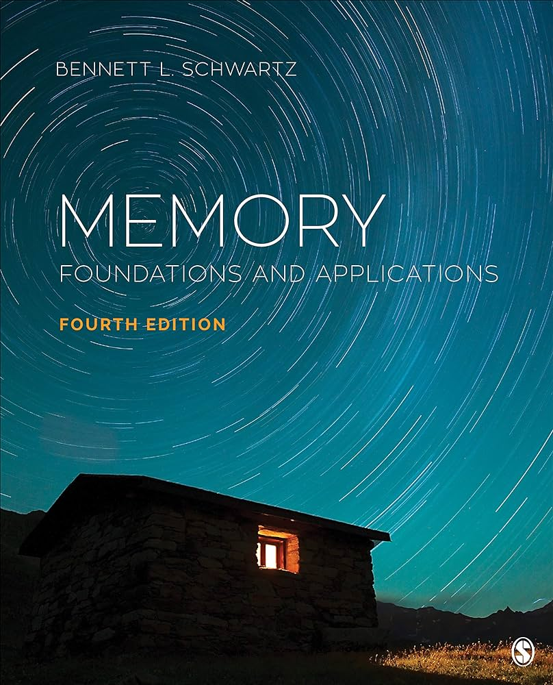
What will I Need?
Textbook: Memory: Foundations and Application by Bennett L. Schwartz (4th Edition) (2020)
Something to take notes with
You!

Slide 6
What’s expected of you
4 Exams (1oo pts each; 400 pts total)
Weekly Discussions (Readings + Questions + In Class) (200 points)
Term Paper (200 points)

Slide 7
Important Dates
First Discussion Day: (X/X) (Next Week)
Exam 1: (X/X)
Paper Due: (X/X)

Slide 8
Questions??

Slide 9
Study these Words
Aroma

Slide 10
Study these Words
Scent

Slide 11
Study these Words
Whiff

Slide 12
Study these Words
Stench

Slide 13
Study these Words
Nose

Slide 14
Study these Words
Breathe

Slide 15
Study these Words
Perfume

Slide 16
Study these Words
Fragrance

Slide 17
Discussion: Why Memory?
What is memory for? What does it do for us?
Notes:
So, if the essential task of a memory system is to carry information forward in time, what properties should that system have? Think about the memory devices you use in everyday life: A USB stick, a post-it note, your mind, etc. What do they need to be able to do?

Slide 18
Discussion: Why Memory?
What kind of memory devices do you use each day?
Notes:
So, if the essential task of a memory system is to carry information forward in time, what properties should that system have? Think about the memory devices you use in everyday life: A USB stick, a post-it note, your mind, etc. What do they need to be able to do?

Slide 19
Types of Memory
Sensory vs. Short-Term vs. Long-term

Slide 20
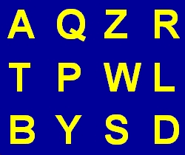
Sensory Memory Example

Slide 21
Sensory Memory Example
How many letters do you remember?

Slide 22
Short-term Memory
Requires Active Maintenance to prevent forgetting
Example: Remembering digits of a phone number
What else?

Slide 23
Long-term Memory
Many different types
  Implicit vs. Explicit
  Autobiographical vs. Semantic

Slide 24
Memory Test
Write down as many words as you remember from earlier in today’s class.

Slide 25
Memory Errors
Types of memory problems?
Forgetting
False Memories
  Deese-Rodieger-McDermott Illusion (DRM)

